Slide 1
Ethnic Proximity and Cross-Cultural Adaptation: A study of Asian and European Students in the U.S.
Kim, Y. S., & Kim, Y. Y. (2016).
Intercultural Communication Studies, 25(3), 61-80.
Presented by ZHANG Wei
September 23, 2022

Slide 2
Background
➡️
Level of Stress
Local American Students
International Students
Sources of Stress
Symptoms of Stress
European Students
Asian Students

Slide 3
Background
➡️
Level of Stress
Local American Students
International Students
Sources of Stress
Symptoms of Stress
European Students
Asian Students

Slide 4
Background
➡️
Level of Stress
Local American Students
International Students
Sources of Stress
Symptoms of Stress
European Students
Asian Students

Slide 5
Background
➡️
Level of Stress
Local American Students
International Students
Sources of Stress
Symptoms of Stress
European Students
Asian Students

Slide 6
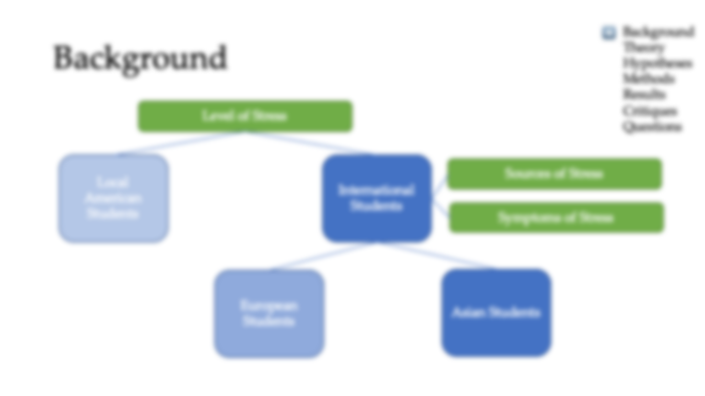
Background
➡️
Level of Stress
Why are the differences?
Any systematic explanations?
Local American Students
International Students
Sources of Stress
Symptoms of Stress
European Students
Asian Students

Slide 7
Kim & Kim (2016)
➡️
Research topic:
“the role of ethnicity in shaping the adaptation process among international students in the United States” (p.65)
Theory: Integrative Theory of Cross-Cultural Adaptation
Hypotheses
Methods: Quantitative & Qualitative methods
Results:
the closer to the host ethnicity, the better host communication competence, the greater involvement of host interpersonal communication…
Critiques
Further Questions

Slide 8
Integrative Theory of Cross-Cultural Adaptation
➡️
What is the essential nature of the adaptation process individual settlers undergo over time
Why are some settlers more successful than others in attaining a level of fitness in the host environment

Slide 9
Integrative Theory of Cross-Cultural Adaptation
➡️
What is the essential nature of the adaptation process individual settlers undergo over time
Why are some settlers more successful than others in attaining a level of fitness in the host environment

Slide 10
Integrative Theory of Cross-Cultural Adaptation
➡️
ENVIRONMENT: Host Receptivity; Host Conformity Pressure; Ethnic Group Strength
PREDISPOSITION:
Preparedness for Change
Ethnic Proximity
Adaptive Personality
INTERCULTURAL TRANSFORMATION:
Functional Fitness
Psychological Health
Intercultural Identity
Host IC
Host
Communication
Competence
Ethnic IC
Host MC
Ethnic MC
Personal communication
Social communication

Slide 11
Integrative Theory of Cross-Cultural Adaptation
➡️
ENVIRONMENT: Host Receptivity; Host Conformity Pressure; Ethnic Group Strength
PREDISPOSITION:
Preparedness for Change
Ethnic Proximity
Adaptive Personality
INTERCULTURAL TRANSFORMATION:
Functional Fitness
Psychological Health
Intercultural Identity
Host IC
Host
Communication
Competence
Ethnic IC
Host MC
Ethnic MC
Personal communication
Social communication

Slide 12
Integrative Theory of Cross-Cultural Adaptation
➡️
ENVIRONMENT: Host Receptivity; Host Conformity Pressure; Ethnic Group Strength
PREDISPOSITION:
Preparedness for Change
Ethnic Proximity
Adaptive Personality
INTERCULTURAL TRANSFORMATION:
Functional Fitness
Psychological Health
Intercultural Identity
Host IC
Host
Communication
Competence
Ethnic IC
Host MC
Ethnic MC
Personal communication
Social communication

Slide 13
Integrative Theory of Cross-Cultural Adaptation
➡️
ENVIRONMENT: Host Receptivity; Host Conformity Pressure; Ethnic Group Strength
PREDISPOSITION:
Preparedness for Change
Ethnic Proximity
Adaptive Personality
INTERCULTURAL TRANSFORMATION:
Functional Fitness
Psychological Health
Intercultural Identity
Host IC
Host
Communication
Competence
Ethnic IC
Host MC
Ethnic MC
Personal communication
Social communication

Slide 14
Integrative Theory of Cross-Cultural Adaptation
➡️
ENVIRONMENT: Host Receptivity; Host Conformity Pressure; Ethnic Group Strength
PREDISPOSITION:
Preparedness for Change
Ethnic Proximity
Adaptive Personality
INTERCULTURAL TRANSFORMATION:
Functional Fitness
Psychological Health
Intercultural Identity
Host IC
Host
Communication
Competence
Ethnic IC
Host MC
Ethnic MC
Personal communication
Social communication

Slide 15
Integrative Theory of Cross-Cultural Adaptation
➡️
ENVIRONMENT: Host Receptivity; Host Conformity Pressure; Ethnic Group Strength
PREDISPOSITION:
Preparedness for Change
Ethnic Proximity
Adaptive Personality
INTERCULTURAL TRANSFORMATION:
Functional Fitness
Psychological Health
Intercultural Identity
Host IC
Host
Communication
Competence
Ethnic IC
Host MC
Ethnic MC
Personal communication
Social communication

Slide 16
Integrative Theory of Cross-Cultural Adaptation
➡️
ENVIRONMENT: Host Receptivity; Host Conformity Pressure; Ethnic Group Strength
PREDISPOSITION:
Preparedness for Change
Ethnic Proximity
Adaptive Personality
INTERCULTURAL TRANSFORMATION:
Functional Fitness
Psychological Health
Intercultural Identity
Host IC
Host
Communication
Competence
Ethnic IC
Host MC
Ethnic MC
Personal communication
Social communication

Slide 17
Hypotheses
➡️
Ethnic Proximity
H1
H2
Host communication competence
H5
Host interpersonal communication
H3
H4
Psychological health

Slide 18
Hypotheses
➡️
Ethnic Proximity
H1
H2
Host communication competence
H5
Host interpersonal communication
H3
H4
H1&H2: t test
H3&H4&H5: correlation test
thematic analysis
Psychological health

Slide 19
Mixed Method
➡️
Phase 1 Questionnaire Survey
Phase 2 In-depth Interview

Slide 20
Phase 1: Questionnaire Survey
➡️
Sampling: convenience sampling and snowball sampling
Participants: European and Asian students of five universities in American central-south region
150(sent)-50(did not return)-7(incomplete)=93 questionnaires
N(sample) = ½ N(population)

Slide 21
Phase 1: Participants
➡️
Nationality | 59% Asian |  | 41% European
Age | From 18 to 52 (Mean = 26.85, SD=9.82)
Gender | 45.2% male |  | 54.8% female
Degree | 34.4% undergraduates | 31.1% master | 22% doctoral | 12.5% non-degree programs
Lengths of residence | From 4 month to 13 years and 9 months (Mean=2.5 year, SD=2.6)

Slide 22
Phase 1: Operationalization
➡️
Items adapted from previous studies
Seven-point Likert-type scale
Cronbach’s Alpha
Host communication competence
Host interpersonal communication (level of intimacy)
Ethnic proximity (extrinsic; intrinsic)
Psychological health (satisfaction; alienation)

Slide 23

Phase 1: Operationalization
Host communication competence
Cognitive
Host language ability
Q1
…
Q9
Knowledge of host culture
Q1
…
Q5
Affective - Adaptation motive
Q1
…
Q5
Operational - Behavioral competence scale
Q1
…
Q8
1 | not at all
2
3
4 | fairly
5
6
7 | completely

Slide 24
Phase 2: In-depth Interview
➡️
Sampling: quota sampling (age and lengths of residence)
Participants: 12 Europeans and 12 Asians
Location: library conference room/cafeteria/by phone
Duration: 40 min to 1 hour
Details:
Questions delve into the four constructs
Follow up questions to explore details
Thematic analysis of the transcripts
Two coders

Slide 25
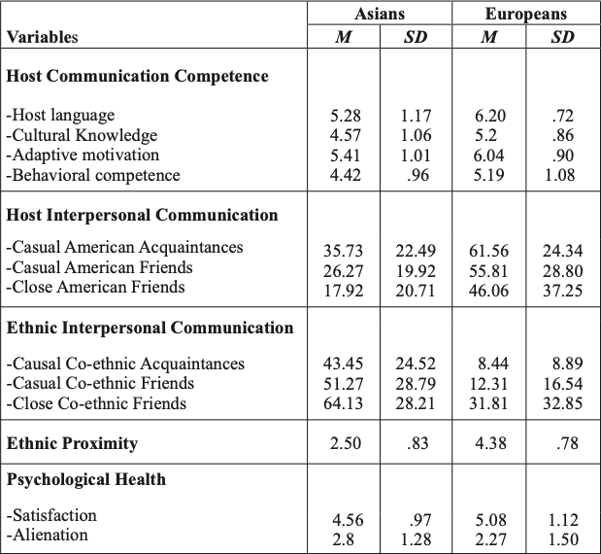
Results: Descriptive Analysis
➡️

Slide 26





Results: Descriptive Analysis
➡️
E>A

Slide 27
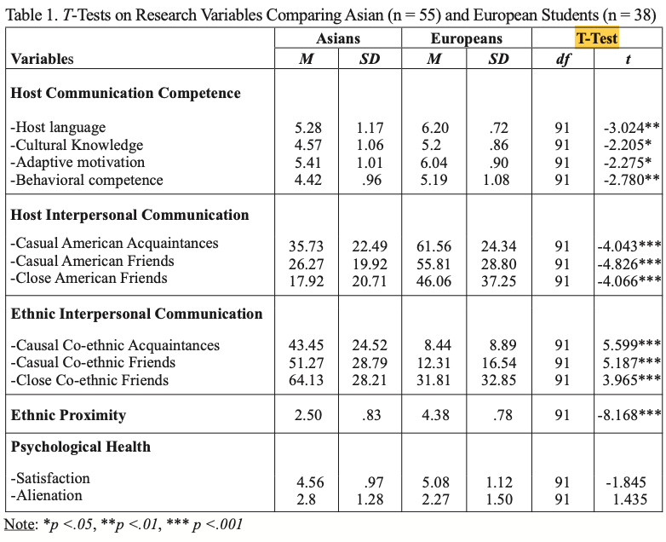

Results: Hypotheses Testing
➡️

Slide 28
Results: Hypotheses Testing
➡️
H1✅ H2✅

Slide 29
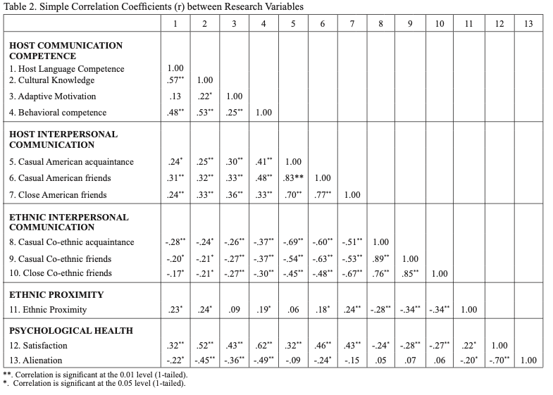
Results: Hypotheses Testing
➡️

Slide 30




Results: Hypotheses Testing
➡️

Slide 31
Results: Hypotheses Testing
H3✅ H4✅ H5✅
➡️

Slide 32
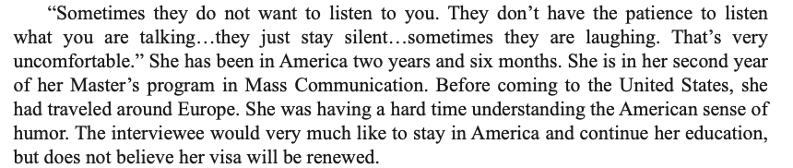



Interview Results
➡️
Ethnic proximity
Host communication competence

Slide 33
Critiques
Asian
Students
European
Students
Ethnic Proximity
➡️
Merits
Demerits
A t-test of two groups is insufficient to establish a relationship between two variable;
Correlation Coefficient 11-3 is insignificant, which negates their H1;
The variable - interpersonal communication – is not properly operationalized.

Slide 34
Critiques
➡️
European
Students
Host communication competence
Asian
Students
Ethnic Proximity

Slide 35
Critiques
Mexican
Students
➡️
European
Students
Australia?
India?
Host communication competence
South Africa?
Asian
Students
Ethnic Proximity

Slide 36
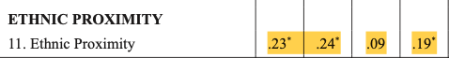
Critiques
➡️
Merits
Demerits
A t-test of two groups is insufficient to establish a relationship between two variable;
Correlation Coefficient 11-3 is insignificant, which negates their H1;
The variable - interpersonal communication – is not properly operationalized.

Slide 37
Critiques
➡️
Merits
Demerits
A t-test of two groups is insufficient to establish a relationship between two variable;
Correlation Coefficient 11-3 is insignificant, which negates their H1;
The variable - interpersonal communication – is not properly operationalized.

Slide 38
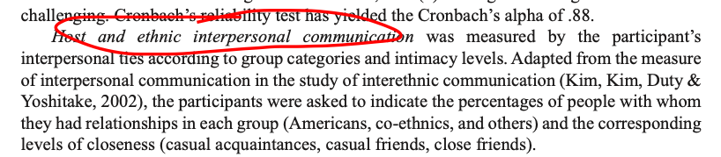
Critiques
➡️
Merits
Demerits

Slide 39
Questions
Which factors are easier to change so as to help the migrants?
What measures can be taken to change these factors?
Are there any other factors missing?
What role do home and host culture play in migrants’ adaptation process?
Do social networks hinder one’s adaptation to the host environment or facilitate it?
How to think of the way of dividing host C and ethnic C into two different poles?
➡️

Slide 40
THANKS FOR LISTENING
Kim, Y. S., & Kim, Y. Y. (2016). Ethnic Proximity and Cross-Cultural Adaptation: A study of Asian and European Students in the United States. Intercultural Communication Studies, 25(3), 61-80.
Salkind, N. J. (2014). Statistics for People Who Think They Hate Statistics. SAGE Publications, Inc.
Presented by ZHANG Wei
September 23, 2022

